Slide 1
Welcome!
Question of the Day:
Did you watch the Grammys? Did you have a favorite performance, a favorite winner, someone who should have won?
‹#›

Slide 2
3G.1 Introduction to Graphics
PROFESSOR RAMSEY
GDC 6.318
ramsey@cs.utexas.edu

Slide 3
Announcements
Unit 1 Mock Test and Key added to Canvas, under last Friday’s header.
Last day of printed In-Class Practice Problem. From now on, the problem will be in the slides and y’all will write answers in your notebook/tablet.

Slide 4
Unit 1 Exam - February 7
Monday | Tuesday | Wednesday | Thursday | Friday | Weekend
 |  |  |  | Mock Test during Design Sessions (no programming this week) | Meet with Study Group to take Practice Tests
Practice Test Live! Spring 2023 Exam 7-8:30pm GDC 6.202 | Test Review Fall 2018 Exam 7-8pm GDC 5.302 | Test Review in Lecture TEST* 6:30-8:30pm BUR 106
OUR TEST THIS SEMESTER - No Graphics or Scanners
* There is an extra time test for students with accommodations who have been approved ahead of time. There is also an alternate time test for students with a UT testing conflict and who have been approved ahead of time. The day, time and location of these tests will be emailed to the approved students.
‹#›

Slide 5
3.2 - 3.3 Quiz

Slide 6
3G.1
Introduction
to Graphics
Notes:
Session Title: Project Based Learning (PBL) for Equity in CS classes
Session Description: If you are teaching a survey course like Computer Science Principles, or a code intensive course like AP CS A, PBL can serve as a powerful tool to increase student interest and engagement. Learn about research that connects PBL to improved student outcomes, especially for girls and underrepresented minorities. Discover available PBL resources and understand PBL lesson components, so you can build your own.

Slide 7
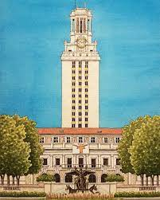
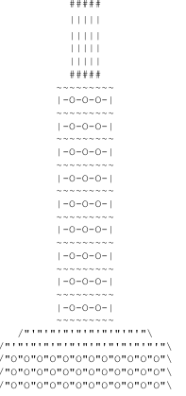
We Can’t Do ASCII Art Forever

Slide 8
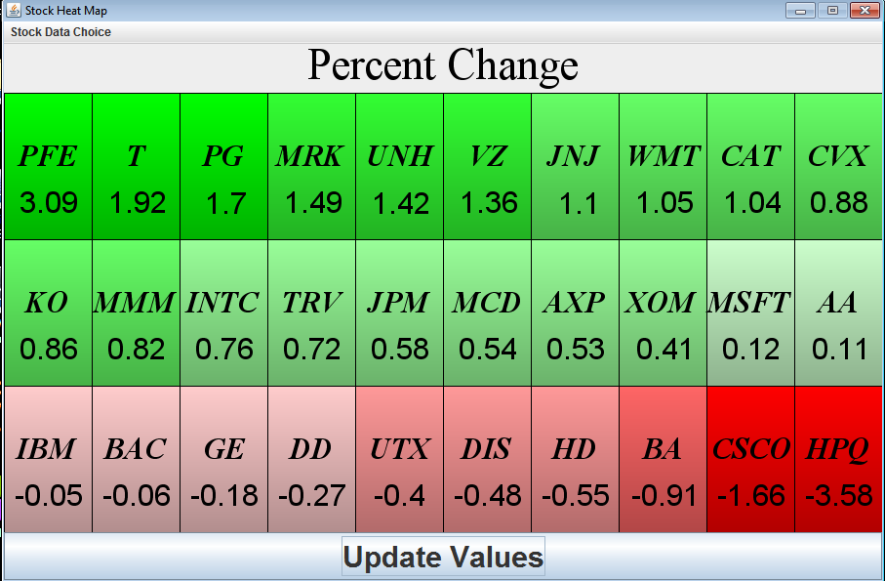
Graphics Example - Heat Map

Slide 9
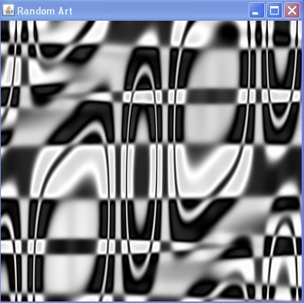
Graphics Example - Art
‹#›

Slide 10
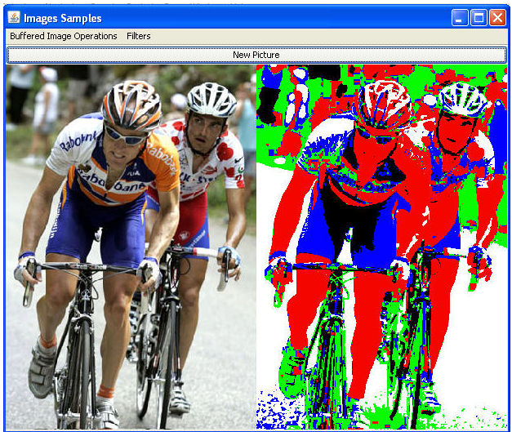
Graphics Example - Photo Manipulation
‹#›

Slide 11
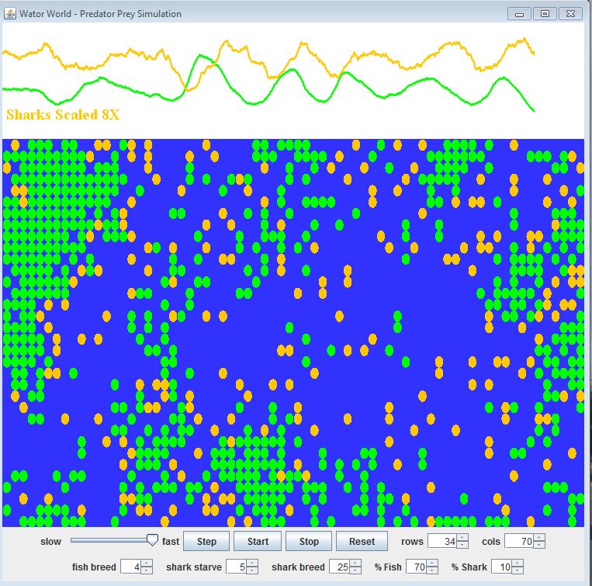
Graphic Examples - Shark Simulation

Slide 12
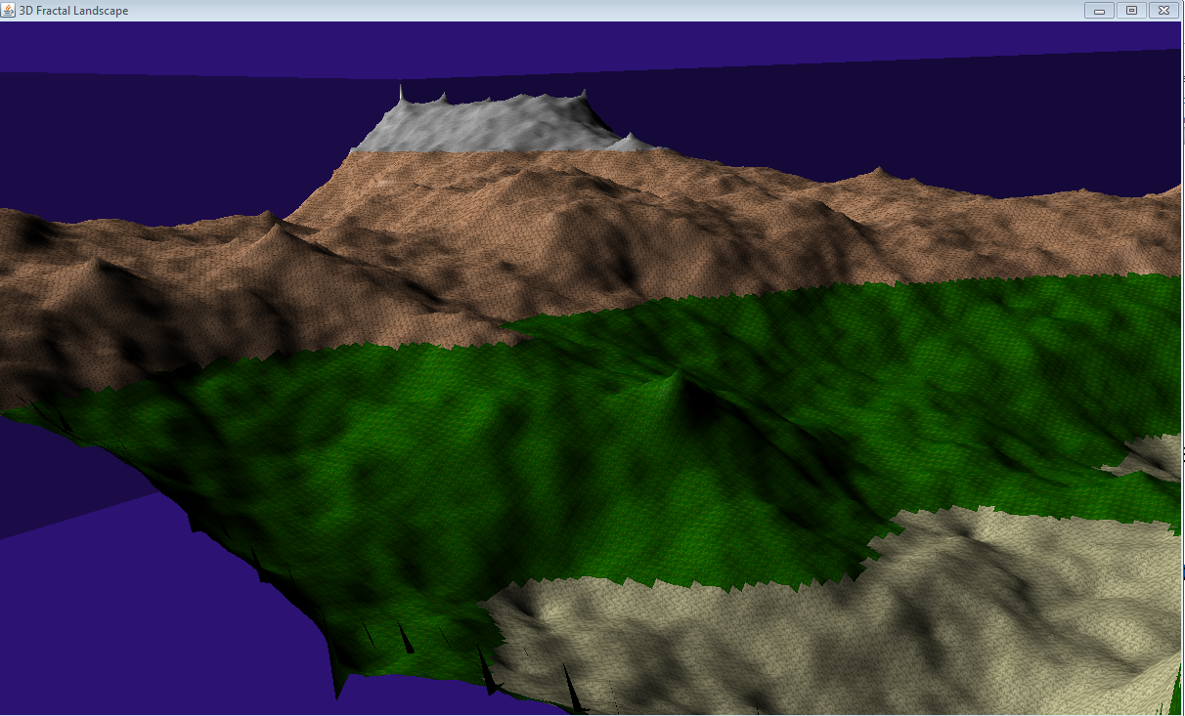
Graphics Example - Fractal 3D Landscape
‹#›

Slide 13
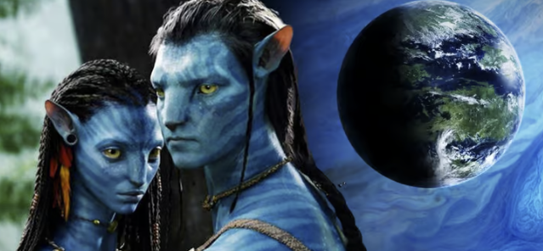
Movies (just kidding)

Slide 14
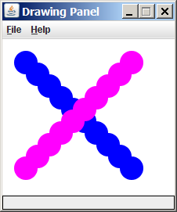
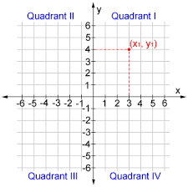
Java Drawing Panel
Like this quadrant, but flipped.
x =====>
(x,y)
(0,0) (300,0)
y
(0,500) (300,500)
=====>
‹#›

Slide 15
Java Drawing Options
x =====>
(x,y)
(0,0) (800,0)
y
(0,500) (800,500)
drawLine()
drawRect()
Indicates
x, y location
drawOval()
=====>
fillRect()
filOval()
drawString()
‹#›

Slide 16
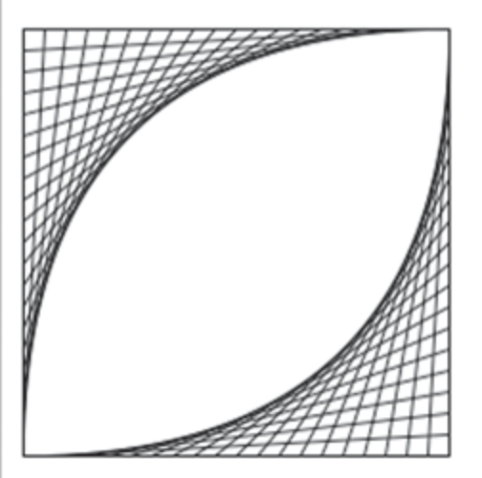
Graphic Examples

Slide 17
Demo
Demo 1

Slide 18
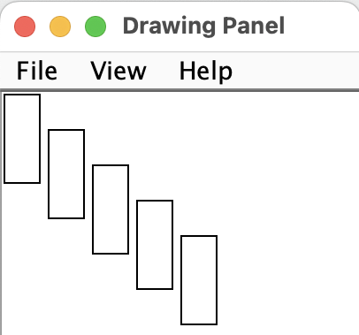
Answer
Output

Slide 19
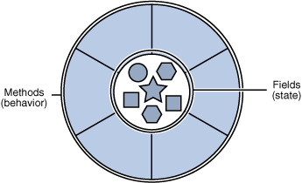
A Detour - Objects
object: An entity that contains data and behavior.
data - variables inside the object
behavior - methods called on object
You interact with the methods.
The data is hidden in the object.
A class is a data type. You make your own!
‹#›
Notes:
‹#›

Slide 20
Graphical Objects
We will draw graphics in Java using three objects:
DrawingPanel: A window on the screen; a blank canvas. Not part of standard Java; provided by the authors.
Graphics: A "pen" to draw shapes and lines on a window.
Color: Colors in which to draw shapes.
‹#›
Notes:
‹#›

Slide 21
Java Library and Package
Library: A related collection of Java packages.
Package: A related collection of Java classes.
The Java JDK provides libraries and packages.
Import only the packages you need.
Best of both - don’t have ALL Java classes in memory when you run a given program, but also have lot of functionality.
‹#›
Notes:
‹#›

Slide 22
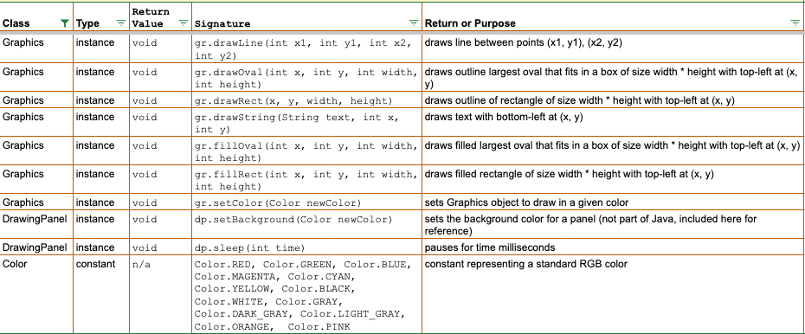
Java Class Reference - Graphics, Drawing Panel, Color

Slide 23
Graphics Parameters
Common Pattern:
x location, y location,
width (change in x), height, (change in y)

Slide 24
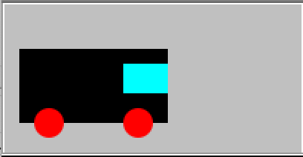
Demo 2 - Draw a Truck
(0, 0)
Demo
truck is 100 by 50
window is 30 by 20
wheels are 20 in diameter
(10, 30)
(80, 40)
(20, 70)
(80, 70)
(200, 100)

Slide 25
In-Class Practice
3G.1 In-Class Practice

Slide 26
Remember
You Belong Here
Unit 1 Test on Wednesday
Practice, Practice, Practice
You got this.

Slide 27
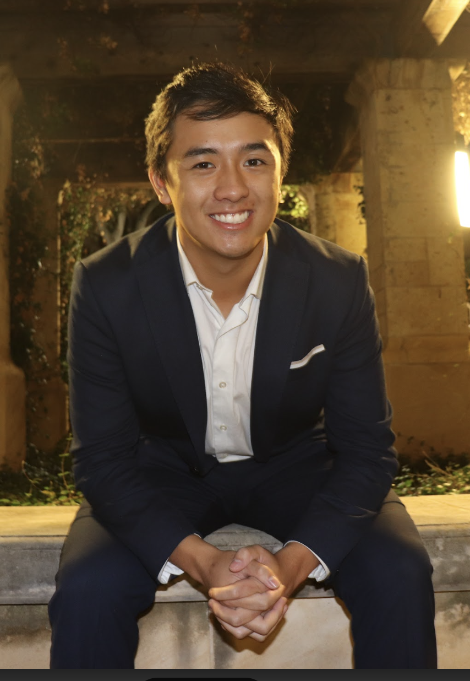
Monday CS Tip
OH, all of basic java help is online if you don’t understand anything in class.
Andrew Dang

Slide 28
Blueprint - Using Graphic Objects
Keyword new creates a new object of a given class/type.
Access the object though its methods with <object>.<method>
Modify the graphics object through its methods.
The getGraphics() method does a new for a graphics object and returns it.

Slide 29
Blueprint - Import
Imports must be at the very top of a file, even before the public class header.
import is the keyword telling Java to import a class from a package.
Java package name. awt is the Abstract Windowing Toolkit.
Graphics is the class name within the package.

Slide 30
Blueprint - Graphic Objects
Import the awt.Graphics class.
Keyword new creates a new object of a given class/type.
Access the object though its methods with <object>.<method>
Modify the graphics object through its methods.
The getGraphics() method does a new for a graphics object and returns it.
If a drawing goes outside the bounds of the panel, just the part on the panel will display.

Slide 31
Blueprint - Color Objects
Import the awt.Colors class.
Use setColor method of Graphics object to set color.
Use preset colors: BLACK, BLUE, CYAN, DARK_GRAY, GRAY, GREEN, LIGHT_GRAY, MAGENTA, ORANGE, PINK, RED, WHITE, YELLOW
Create a new Color object.
Providing red, green and blue values, 0-255 each.
Each drawn item uses the most recent color from setColor.

